Slide 1
Agentic Networking is Here
Introducing the Tools & Techniques Required to be Successful

Slide 2
john@netclaw: ~/talks/naf-2026 — claude — 120×40
✻ Welcome to Claude Code
cwd: ~/talks/naf-2026/change-the-industry
> I have 25 minutes to change an entire industry. I need a solid presentation covering updates and evolutionary changes in the year since I've been on stage. Make no mistakes. Make good decisions. Loop for 25 minutes and use the spec-driven development process and Spec Kit to generate this content. You have access to many MCPs and RAG sources to ensure the content is factual. Be funny, but CCIE funny. ultrathink
● /speckit.specify "change an entire industry"
⎿ spec.md written. 1 requirement: "be amazing"
● /speckit.clarify
⎿ Q: Which industry? A: yes
● netclaw-mcp · show audience detail
⎿ WARN 300 humans detected. Humans do not parse JSON.
● Ralph loop 1 of ∞ · I'm helping!
✻ Vibing… (24m 59s · ↓ 1.2M tokens · esc to interrupt)
> ▌

Slide 3
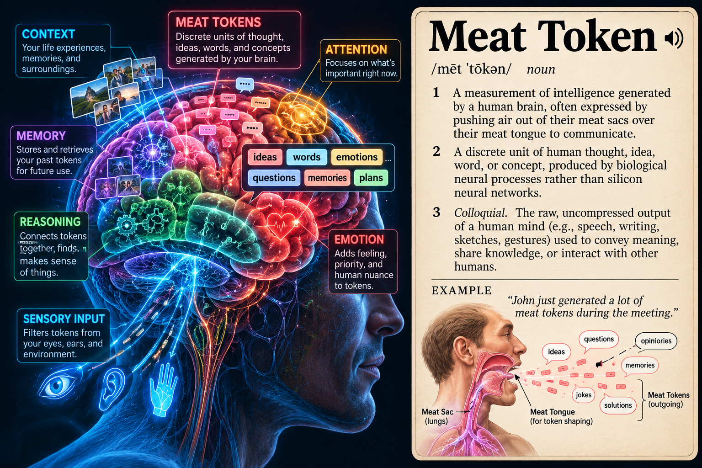

Slide 4
Agenda
25 minutes, then 10 minutes for your questions
01
Re-introduction
Who I am, and why I'm back with good news
3 min
02
How I built it
The tools and techniques, from RAG to spec-driven development
10 min
03
What I built
NetClaw: an AI agent that is better at networking than humans
12 min

Slide 5
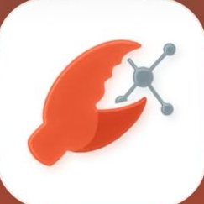
Yes, I did
The rapid-fire recap
Yes, I worked in an aluminum factory for 5 years while going to college
Yes, I was a network engineer for 15 years: Empire Life, then Senior Architect for the Parliament of Canada
Yes, I was one of Cisco's first AI Technical Leaders
Yes, I left to chase AI full time at Selector
Yes, I am now Head of AI and DevRel at Itential, since the start of 2026

Slide 6
Updates
Please watch last year’s video, it will save me a lot of time, but…
That aluminum factory? It just laid off 35% of its production workforce
On expertise: I said NOT to call me an expert; now I’m a Google Developer Expert
Head of AI and DevRel for Itential as of January 5th
Found an entirely new way of working
Started a new open source project called “NetClaw”
Started a movement behind VibeOps

Slide 7
FAQ
The top four questions I get
01
What are your technical abilities? You must have some superpower or be some kind of genius.
02
Why does Itential pay you?

Slide 8


Slide 9
FAQ, continued
The top four questions I get
03
You don’t write code anymore?
Not a single character since February 2026.
04
You don’t even READ the code anymore?
I don’t even know what language the agent is using.

Slide 10
01
How I Build Things
The tools and techniques, from RAG to spec-driven development

Slide 11
Eleven months of frontier models
From my AC4 talk to NetClaw’s launch to today’s Mythos-class models
Nov 17–21, 2025 NAF AC4
Feb 2026 NetClaw launches
Oct 2026 Today
OpenAI
GPT-5.1
GPT-5.1-Codex-Max
GPT-5.3-Codex
Feb 5
GPT-6 Astra · 6.1 Sol
Sept 3 and Sept 29
Anthropic
Claude Sonnet 4.5
Opus 4.5 lands Nov 24
Claude Opus 4.6
Feb 5 · 1M context (beta)
Claude Fable 5.1 · Opus 5.5
Mythos-class · Sept 2026
Google
Gemini 3 Pro
Launched Nov 18 with Antigravity
Gemini 3.1 Pro
Preview, Feb 19
Gemini 4 Argon
GA Oct 13
Open weight
Kimi K2 Thinking
Moonshot AI
Kimi K2 · GLM · Qwen3
Moonshot, Z.ai, Alibaba
Kimi K3
2.8T parameters · July 27
Sources: OpenAI, Anthropic and Google release notes; Wikipedia (GPT-5.2, GPT-5.3-Codex, Claude); BridgeBench and slash-digital.io model trackers, Sept–Oct 2026.

Slide 12
What changed between AC4 and today
Why today’s models run a network loop that Nov 2025 models could not
1M tokens
Context is now the default
A whole topology, configs and show output fit in one window; Haiku 5.5 ships 1M at $0.10 per million input tokens
Hours, not minutes
Long-running agents
Opus 4.6 was rated for 14.5-hour tasks; Fable 5.1 is built for long-running agents
128K output
Whole artifacts in one pass
Full configs, specs and test reports instead of snippets
Parallel agents
One task, many workers
GPT-6 Pro splits a task across several agents working at once
Adaptive thinking
Effort you can dial
Low to max effort per call, so loops spend tokens where they matter
Open weights caught up
Frontier-class you can self-host
Kimi K3 scores 93.5% on GPQA Diamond; DeepSeek V4.1 Flash is MIT-licensed
Sources: Anthropic and OpenAI launch notes; The AI Corner (Opus 4.6, 2026); slash-digital.io and morphllm.com model rankings, Oct 2026. Vendor-reported figures.

Slide 13
From talking about my network to operating it
Find where you are on the progression. Skipping stages is fine now, everything is abstracted.
2023–24
2025
2025
2025–26
2026
RAG
Grounds the model in real docs and knowledge
Vector stores, RAPTOR trees, GraphRAG
MCP
Gives the model tools with determinism, control and scope
pyATS, NetBox and ACI MCP servers, read-only first
A2A
Agents find and delegate work to other agents
Agent cards, task lifecycle
Harnesses
Claude Code in the cloud, Ollama on local hardware
The right model for each job
Loops + Specs
Ralph Wiggum loops, spec-driven development, Spec Kit
Iterate until verifiably done

Slide 14



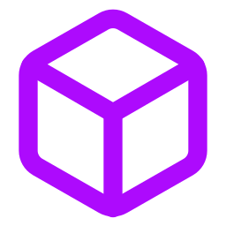

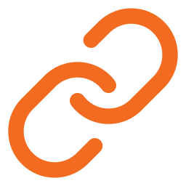
What is OpenClaw?
The Foundation of Agentic AI
Released November 2025 by Peter Steinberger
60,000 GitHub stars in days - fastest-growing open source project in history
Not a chatbot.
Not a copilot.
An autonomous coworker.
Jensen Huang called it "the operating system for personal AI"
Open-source AI agent framework and runtime environment
Supports 30+ AI providers (Anthropic, OpenAI, Bedrock, Vertex, local models)
20+ communication channels out of the box

Slide 15
Clawd became OpenClaw in about ten weeks,
Which became NetClaw in three weeks
One developer’s personal assistant became the runtime NetClaw is built on
Nov 24, 2025
Jan 2, 2026
Jan 25, 2026
Jan 27, 2026
Jan 30, 2026
Feb 19, 2026
Clawd
Peter Steinberger’s personal AI assistant, named after Claude
Clawdbot
Open-sourced as an agent that talks to you on the chat apps you already use
Viral
About 149K GitHub stars in a single week
Moltbot
Renamed after Anthropic’s trademark request; the lobster molts
OpenClaw
Final name three days later. In February the project moved to a foundation
NetClaw
An open-source AI network engineering agent built on OpenClaw
Sources: Wikipedia, “OpenClaw” and “Peter Steinberger (programmer)”; Forbes, February 16, 2026.

Slide 16
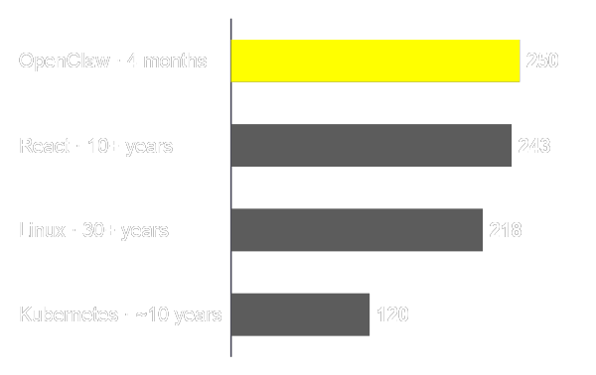
Jensen Huang calls OpenClaw the new Linux
NVIDIA GTC 2026 keynote, March 16
“OpenClaw has open sourced the operating system of agentic computers.”
GitHub stars, early March 2026
Time each project took to get there
“Every single company in the world today has to have an OpenClaw strategy.”
“The most popular open source project in the history of humanity.”
Sources: Jensen Huang, NVIDIA GTC 2026 keynote, as reported by Fierce Network and CrewClaw; star counts from star-history.com and WinBuzzer, March 1–3, 2026.

Slide 17


OpenClaw Changed Everything
From AI You Talk To, to AI That Acts
BEFORE
AFTER
Chatbots that suggest actions
Agents that own the outcome
Manual tool execution
Autonomous multi-step workflows
Context-switching between apps
Conversation IS the interface
Template-driven automation
Reasoning-driven decisions

Slide 18

“It’s better to fail predictably than succeed unpredictably.”
— Geoffrey Huntley, creator of the Ralph loop

Slide 19
Ralph Wiggum Loops
Brute-force persistence with a fresh context every time

Slide 20
“Ralph is a Bash loop.”
while :; do cat PROMPT.md | claude-code ; done
Geoffrey Huntley, July 2025
while :; do … done
Run forever, until a human or a stop rule ends it
cat PROMPT.md
Feed the same instructions every time; the plan on disk changes, the prompt doesn't
| claude-code
Start a fresh agent process with an empty context window

Slide 21
Ralph works because the filesystem remembers what the model forgets
1
Fresh context every loop
Each iteration starts a new agent process, so context rot never builds up
2
State lives on disk
Specs, the plan, the code and git history carry progress between iterations
3
One task per iteration
Small, finished steps instead of one long session that drifts
4
Backpressure from tests
Builds, tests and linters reject bad work, and the failure output feeds the next loop
“LLMs are stateless. Filesystems aren't.”

Slide 22
Each Ralph iteration reads the plan, ships one task and exits
1 Read
PROMPT.md and the specs
2 Pick
The top task in the plan
3 Implement
That one task only
4 Verify
Build, tests, linters
5 Record
Commit and tick the task
6 Exit
The loop starts a fresh agent
Repeat until the plan is empty
On disk: the memory that survives each loop
specs/*.md
IMPLEMENTATION_PLAN.md
src/ and tests/
git history

Slide 23
Ralph runs in two modes: plan first, then build
Plan mode
Compare the specs against the current code
Write a prioritized IMPLEMENTATION_PLAN.md
Change no code
Build mode
Take the top task from the plan
Implement it and run the tests
Commit, tick the task, exit

Slide 24
Ralph needs guardrails because it never decides to stop on its own
Iteration cap
A hard maximum, such as 50 loops
Completion promise
The agent prints DONE only when the tests pass
Sandbox
Scoped permissions and no production credentials
Budget
Huntley measured about $10.42 an hour running Sonnet 4.5 in a loop
Review at the commit, not at every keystroke

Slide 25
Within a year, the harnesses built Ralph in as a native command
Jul 2025
Ralph is a hand-written Bash loop
while :; do … done
Mar 2026
Claude Code adds a recurring /loop command
/loop
Apr 2026
Codex adds goals with machine-checkable completion conditions
goal objects
May 2026
Claude Code and other harnesses add /goal
/goal
Jun 2026
The practice gets a name: loop engineering
/loop + /goal + verifier
Anthropic also packaged the technique as an official Claude Code plugin, ralph-loop.

Slide 26
For networks, Ralph loops until the config passes validation
# PROMPT.md
Study specs/bgp-peering.md.
Pick the highest-priority unchecked item
in IMPLEMENTATION_PLAN.md.
Generate the config for that item only.
Run: make validate
If it fails, read the errors and fix.
When it passes: commit, tick the item,
and exit.
What make validate can run
Syntax lint
Vendor parser rejects malformed config
Batfish
Reachability and policy checks on a model of the network
pyATS in a lab
Live state checks against virtual devices
Pre/post diff
Proves nothing changed that the spec didn't ask for

Slide 27
NetClaw started as three Ralph missions
First commit Feb 21, 2026 · 75 iterations per mission · MISSIONXX.md files in the repo
The build agent
Claude Code with the Ralph extension loaded
MCPs, RAG and primitive “skills” for context
One MISSIONXX.md as the spec for each run
A 75-iteration cap per mission
MISSION01.md · Core agent
pyATS agent, 7 skills, Markmap, Draw.io, RFC lookup, NVD CVE, SOUL v1
MISSION02.md · Full platform
37 MCP servers, 82 skills across 16 domains, SOUL v2
MISSION03.md · NetClaw Mesh
NetClaws peer with each other over BGP via ngrok, matched by AS number
Six days in: 160+ stars, 35+ forks, 82 skills and 37 MCP server backends.
Sources: github.com/automateyournetwork/netclaw (MISSION01–03.md); “6 days of netclaw – by netclaw,” automateyournetwork.com, Feb 27, 2026.

Slide 28
Where It Started: Ralph Wiggum Loops
From brute-force loops to tightly scoped specs, built in the open
FEB 2026
MAR 2026
TODAY
Ralph Wiggum Loops
The Pivot to Spec Kit
Specs in the Open
The loop: feed the agent the same prompt until the job is done
Three missions seeded the build, in RALPH INPUTS/
Six days: 82 skills and 160 stars
The drift: capabilities landed in code but missed the docs, installer or HUD
The fix: Spec-Driven Development and a project constitution
Specs: tight features, typically a SKILL.md and its MCP server
Loops: larger scopes of work, structural changes, security reviews
Both: loops run inside specs
The lesson: a loop gets you speed; a spec keeps what you built predictable.

Slide 29
Spec-Driven Development
Write the intent down before anyone writes code

Slide 30
In SDD the spec is the source of truth and code is the output
Code-First
Spec-First
Prompt, read the code, fix, prompt again
Intent lives in chat history and is lost
A change means rewriting code by hand
Reviewers read diffs and guess the intent
Intent, then spec, plan, tasks and code
Intent lives in versioned Markdown in the repo
A change means editing the spec and regenerating
Reviewers approve intent before code exists

Slide 31
Spec-Driven Development
Specs before code, made repeatable with GitHub's Spec Kit. One item, one spec, one branch
Specify
Clarify
Plan
Tasks
Implement
Verify
Specify /speckit.specify → spec.md
What to build and why, with no technology choices
Clarify /speckit.clarify
The agent asks questions until the spec has no gaps
Plan /speckit.plan → plan.md
Architecture, data model and contracts for the spec
Tasks /speckit.tasks → tasks.md
Ordered, testable tasks; /speckit.analyze checks they match
Implement /speckit.implement
The agent works the task list, a Ralph loop with an exit
Verify Tests, docs and installer
Done means passing checks and every surface updated
Each roadmap item is a hypothesis. The measurement is the first deliverable, and it corrected the roadmap four times.
A constitution keeps README, installer, SOUL.md, HUD and config in sync for every new capability.

Slide 32
Itential Builder Skills: every stage has an engineer gate
17 skills that teach Claude Code, Codex or Copilot to build on Itential, the SDD way
Stage | Agent | Artifact | Engineer gate
01 Requirements | spec-agent | customer-spec.md | Approves the spec
02 Feasibility | solution-arch-agent | feasibility.md | Approves the feasibility decision
03 Design | solution-arch-agent | solution-design.md | Approves the design
04 Build | builder-agent | Deployed assets | Reviews and accepts the delivery
05 Test | qa-agent | test-plan.md, test-report.md | Approves the plan before anything runs live
06 As-Built | qa-agent | as-built.md | Signs off
The agent that builds never certifies its own work: version 2 hands Test and As-Built to a separate qa-agent.

Slide 33
Spec Kit & Itential Skills add SDD commands to the coding agent you already use
SPEC KIT
ITENTIAL SKILLS
The specify CLI scaffolds a project and installs the slash commands
Works in Claude Code, Codex, Copilot, Cursor and 30+ other agents
Every command is a Markdown prompt file you can read and edit
Every command produces an artifact you review in the repo
Installed into the agent harness alongside Spec Kit
Builder For engineers who build automations
Operator For teams who run the work
Admin For those who manage the platform
TWO WAYS TO WORK
Slash commands → Markdown artifacts
Each step leaves a file you review in the repo
Free-form prompts
Ask in plain language: faster, with less rigor

Slide 34
SDD defines what done looks like; Ralph keeps going until the work gets there
SDD writes the files (you review them)
Ralph runs the loop (fresh context each pass)
constitution.md rules that never change
Read
constitution, spec, plan
Pick
first unchecked task
spec.md acceptance criteria = done
plan.md stack and architecture
Next pass, new process
Build
that task only
tasks.md ordered, checkable tasks
Commit
tick the task, exit
Verify
tests and build pass
Specs without a loop stop after one pass. A loop without specs never knows it has finished.

Slide 35
Run /implement as a Ralph loop: one task from tasks.md per fresh context
PROMPT.md
Why it helps
Each task gets a clean context window, so task 40 is built as carefully as task 1.
Read .specify/memory/constitution.md and specs/001-*/spec.md.
Open specs/001-*/tasks.md; take the first unchecked task.
Implement only that task, then run the tests.
If they pass: tick the task, commit, exit.
If every task is ticked: print ALL_TASKS_DONE.
Two stop rules
The completion word ends it when done; the 30-pass cap ends it if it never converges.
ralph.sh
for i in $(seq 1 30); do
cat PROMPT.md | claude -p | tee -a ralph.log
grep -q ALL_TASKS_DONE ralph.log && break
done
Other harnesses
Codex: codex exec
Claude Code: the ralph-loop plugin

Slide 36
Loop Engineering
Stop prompting the agent. Design the loop that prompts it.

Slide 37
In operations, loop engineering closes the gap between intent and network state
Intent
The spec says what the network should be
Detect drift
State no longer matches intent
Generate
Agent drafts the change
Humans stop writing prompts
We set the goal; the model writes its own prompts on every lap
Observe
Telemetry and state collection
Validate
Verifier tests it before it ships
Approve and deploy
Engineer gate, then governed push

Slide 38
Loops multiply cost and risk as fast as they multiply output
Cost
send scanning and drafting to small models; cap iterations and spend
Runaway loops
every loop needs a hard stop rule
Permissions
least privilege, and no production credentials in build loops
Review gates
humans approve specs, plans and deployments
!
CAUTION

Slide 39
Next comes graph engineering: many loops wired into one governed system
Nodes do the work.
Edges route it, including branches and retries.
A single loop is one node with an edge back to itself.
Builder A ↻
own loop
Intent
spec.md
Planner
splits the work
Verifier
tests, QA agent
Human gate
approve change
Builder B ↻
own loop
fails: route back
Shared state on every edge: specs, artifacts, test results, approvals
The term surfaced in July 2026 and is still contested; the practice (graph-based orchestration) is older.

Slide 40
A loop repeats one agent's cycle; a graph decides which agent works next
 | Loop engineering | Graph engineering
Unit of design | One agent's repeated cycle | A network of agents, tools, verifiers and people
Who picks the next step | The same agent, every pass | Routing rules on the edges between nodes
State | Files and git for one task | Shared, versioned state across all nodes
Verification | Tests at the end of each pass | Dedicated verifier nodes and approval gates
Network example | Loop a config until Batfish passes | Spec, design, parallel builds, QA, change approval
For network teams: Itential workflows already model work as a graph of tasks with approval gates. Graph engineering puts agents on those nodes.

Slide 41
Stacked together, these pieces are VibeOps … sigh .. AgenticOps
Loop engineering Loops that write their own next prompt
VibeOps
AI speed with engineering discipline
SDD and Spec Kit Written intent and review gates
Ralph loop Persistence with a fresh context each lap
Harness Claude Code or Codex: the agent loop with tools
RAG and MCP Your data and your systems
LLM Predicts the next token
Each layer fixes a limit of the one below it.

Slide 42
02
What I Built
NetClaw: an AI agent that is better at networking than humans

Slide 43
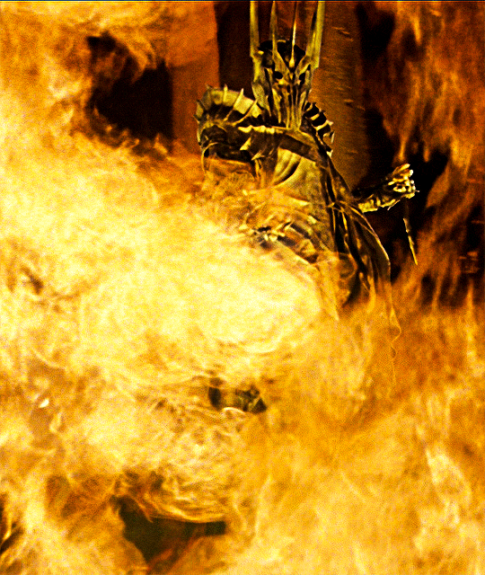
Sauron, The Dark Lord
John Capobianco, creator of NetClaw
Poured all his hate and malice into the One Ring
Poured 25 years of IT Operations hate and malice into NetClaw
One Ring to Rule Them All
One Tool to Rule Them All
One does not simply walk into Mordor
One does not simply install NetClaw
Bearer becomes invisible and acquires dark powers beyond comprehension
User becomes invisible and gains dark powers beyond comprehension
The Great Eye sees all of Middle-earth
NetClaw sees every device, route and flow
One Ring to bring them all, and in the darkness bind them
One agent to bring 176 MCP servers together and bind them
“You shall not pass!”
"Your unapproved change shall not pass"

Slide 44
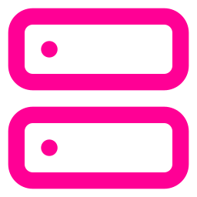





Enter NetClaw
Built on OpenClaw: from personal assistant to personal CCIE
OpenClaw variant built for enterprise networking; Hermes also supported
Not a chatbot - a coworker that reasons about networks
BYOM + BYOMCP + BYOSKILL: bring your own everything
Automates the reasoning, not just the commands
Follows CCIE-level OSI troubleshooting methodology
Composable skills - topology feeds diagrams, security feeds compliance
237 skills and 176 MCP integrations

Slide 45
Three-Tier Architecture
01
OpenClaw Chat
OpenClaw Gateway
Slack / Discord / WebEx
User Interface
Telegram / WhatsApp
Visual 3D HUD
02
Claude LLM (or any provider)
237 Skills in the catalogue
6 Workspace Config Files
Core Agent
SOUL.md - Agent Personality
AGENTS.md - Memory System
03
176 MCP Integrations
JSON-RPC 2.0 stdio
pyATS Device Automation
Tool Backend
Platform API Integrations
Utility & Observability

Slide 46












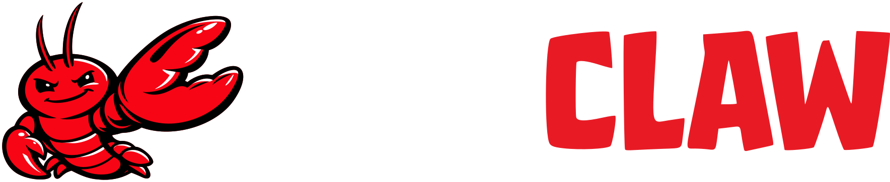


Interfaces
Talk to NetClaw where your team already lives
iMessage
CLI/TUI
Visual 3D HUD
Web Chat
Gateway
Beyond chat: 3D HUD, Canvas/A2UI, Blender and UE5 digital twins, voice, Twilio SMS, Twitter/X, Mobile, Zoom

Slide 47
Six files make the agent who it is
The primary workspace: plain Markdown you can read, edit and version
AGENTS.md
Operating instructions and behavior guidelines, loaded at the start of every session
SOUL.md
Persona, tone, communication style and boundaries, including the 12 safety rules
IDENTITY.md
The agent’s name, vibe and emoji
USER.md
Your stable preferences, communication style and active projects, on its own character budget
MEMORY.md
Curated long-term facts and notes: the agent’s primary notebook
HEARTBEAT.md
A periodic checklist the agent runs on its own, such as health checks
Edit them from chat, the HUD or the VS Code extension; every change is a diff you can review.

Slide 48
12 non-negotiable rules govern every session
SOUL.md loads these rules before NetClaw touches a single device
01 Never guess device state
Run a show command first
02 Never skip the baseline
Capture pre-change state first
03 Never wipe or reload
No write erase, reload, delete or format
04 Never skip the CR
Production needs an approved ServiceNow CR
05 Never auto-quarantine
ISE endpoint moves need a human to confirm
06 NetBox is read-write
Full API access to the source of truth
07 Always verify changes
A failed check keeps the CR open
08 Always commit to GAIT
Every session ends in the audit trail
09 Cite RFCs
When explaining protocol behavior
10 Flag CVEs
When a software version is vulnerable
11 Escalate when unsure
Recommend a human engineer verify first
12 Use the right skill
Follow the structured procedure; no freestyling
Source: NetClaw SOUL.md, “Rules,” github.com/automateyournetwork/netclaw

Slide 49
One NetClaw, two harnesses
Same skills and MCPs on OpenClaw or Hermes; pick the runtime that fits
OpenClaw
TypeScript · control plane first
A gateway that controls channels, devices and isolated workspaces
Identity and behavior in files (SOUL.md, AGENTS.md) you can read and version
Human-authored skills and the largest skill ecosystem
Hermes Agent
Python · Nous Research · agent first
A learning loop that turns successful work into new skills
Layered memory with searchable session history
Built-in cron for unattended, scheduled work
Pick it when: you want an inspectable, multi-channel operator you control
Pick it when: you want one agent that gets better at recurring tasks
Either way: the installer, skills, MCPs and VS Code extension work with both runtimes.
Sources: Turing Post, “Hermes Agent vs OpenClaw,” 2026; Syntalith, “Hermes Agent vs OpenClaw,” 2026; NetClaw 1.11.0 release notes.

Slide 50
3-Ring Defense Architecture
Defense in Depth for AI Agents
RING 1
OpenShell Sandbox
RING 1
RING 2
Kernel isolation | Network namespaces | Deny-by-default
RING 3
DefenseClaw
12
RING 2
Skill scanning | Runtime inspection | LLM guardrails
RULES
RING 3
NetClaw Agent
237 Skills | 176 MCPs | SOUL.md Rules
12 Non-Negotiable Safety Rules

Slide 51
Raw Tools vs. Structured Skills
Skills define what the agent knows; MCPs give determinism, control and scope that raw CLI can't
Raw tool exposure
Structured MCP skills
Hundreds of tool schemas loaded into every turn
A skill loads only the tools its task needs
The model picks the tool and the arguments on its own
SKILL.md encodes the method: what to check, in what order
No method: nothing says what to check first
Read-only by default; writes pass an approval gate
Nothing separates a read from a write
Every call lands in the GAIT audit trail
Output is whatever the device happened to return
Answers state what the evidence does and does not show

Slide 52
Anatomy of a Skill
A skill carries the judgment a tool list cannot
SKILL.md
EXAMPLE
What a SKILL.md carries
percepxion-oob
1
Purpose
The question the skill answers
Two Lantronix MCP servers, 37 tools each:
2
Tools
Which MCP servers it may call
Percepxion SaaS: fleet-wide and async (firmware, bulk config, audit)
slc-mcp-server: one device, synchronous (ports, sessions, CLI)
3
Method
The order of checks an expert would run
4
Guardrails
Read-only by default; writes need approval
The value is the routing rule between them.
The OOB device is the console server; the managed device is the router on its serial port. Confuse the two and the command goes to the wrong hardware.
5
Output
What the evidence does and does not establish

Slide 53
NetClaw Skills
Device Automation & Network Operations
pyATS Device Automation
18 SKILLS
Network Domain Skills
14 SKILLS
Network core automation
Health checks + NetBox cross-ref
Routing (OSPF, BGP, EIGRP, IS-IS)
Security audit + ISE + NVD
Topology discovery + reconciliation
Config management + ServiceNow
Troubleshooting with escalation
Fleet parallel operations
Dynamic test generation
ASA firewall automation
Juniper JunOS
Arista EOS
F5 BIG-IP iControl REST
Linux /​ VMware ESXi
NetBox DCIM/​IPAM reconciliation
ACI fabric audit & change deploy
ISE posture & incident response
ServiceNow change workflow
GAIT session audit tracking
Cisco NSO orchestration
EVPN/​VXLAN fabric workflows
Live BGP/​OSPF participation
Subnet calculator
gNMI streaming telemetry
SD-WAN vManage monitoring
Cisco CML lab simulation
ContainerLab networks
Batfish offline config analysis

Slide 54
NetClaw Skills
Platform Integrations & Security
Platform Skills
18 SKILLS
Security & Utility Skills
16 SKILLS
F5 BIG-IP health/​config/​troubleshoot
Catalyst Center inventory & ops
Cisco Meraki Dashboard mgmt
Cisco ThousandEyes intelligence
Cisco Secure Firewall audit
Palo Alto Panorama
FortiManager integration
Infoblox DDI
AWS cloud networking
GCP cloud networking
Itential orchestration
Arista CloudVision Portal
Jenkins CI/​CD operations
GitLab DevOps integration
GitHub config-as-code
Grafana observability
NVD CVE vulnerability scanning
Nmap network scanning
Gtrace path analysis + IP enrichment
Packet capture analysis
Prometheus PromQL monitoring
Kubeshark K8s traffic analysis
Wikipedia research
RFC lookup & standards
Markmap visualization
Draw.io diagram generation
UML diagram generation
Canvas/​A2UI network viz
MemPalace persistent memory
Microsoft 365 integration
Slack-native operations
WebEx-native operations

Slide 55


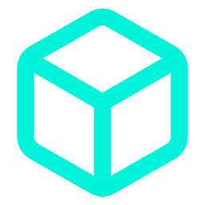
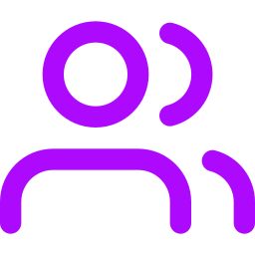
NetClaw Skills
Cloud, Observability, Labs & Collaboration
Cloud & IaC
Observability
Labs & Simulation
Collaboration
AWS
5
Datadog
4
EVE-NG
8
WebEx
5
GCP
3
PagerDuty
4
Cisco CML
5
Voice
5
Azure
2
Splunk
3
GNS3
5
Slack
4
Terraform
3
Flow telemetry
5
ContainerLab
Microsoft 365
3
Vault
3
Grafana
Batfish
Twitter/X
4
Cloudflare
5
Prometheus
Live BGP/OSPF peering
Visualization
2
Zscaler
5
SuzieQ
Memory
2
Skill counts per category from the NetClaw README. The 1.13.0 catalogue holds 237 skills in total.

Slide 56


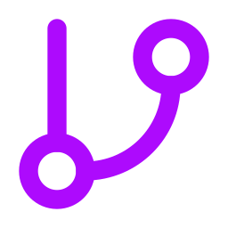
MCP Integrations
176 MCP integrations in the 1.13.0 catalogue. A selection:
Network Device MCPs
Platform MCPs
Observability MCPs
DevOps & Cloud MCPs
pyATS (8 tools)
Cisco ACI
Cisco ISE
Cisco NSO
Juniper JunOS
Arista CVP
F5 BIG-IP
NetBox DCIM/IPAM
ServiceNow ITSM
Cisco Meraki
Cisco SD-WAN
ThousandEyes
Catalyst Center
Infoblox DDI
Grafana
Prometheus
Loki Logging
Kubeshark
Splunk
Datadog
GAIT Audit
GitHub
GitLab
Jenkins CI/CD
AWS Cloud
GCP Cloud
ContainerLab
Cisco CML

Slide 57




MCP Integrations
Device Access, Orchestration, Security & Assurance
Device Access
Orchestration
Security
Assurance
pyATS
Multivendor CLI: SSH/NAPALM, ~175 platform families
Cisco RADKit
Juniper JunOS
Arista CloudVision
Aruba CX
Itential (65+ tools)
Cisco NSO
Ansible Automation Platform
Terraform Cloud
Catalyst Center
Meraki Dashboard
Check Point (15 MCPs, 40+ tools)
Cisco FMC
Palo Alto Panorama
Fortinet
Cisco ISE
Claroty OT/IoT
Forward Networks digital twin (54 tools)
IP Fabric
Batfish
SuzieQ
ThousandEyes
ANTA

Slide 58

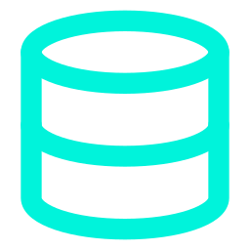

MCP Integrations
Out-of-Band, Internet Vantage, Data & Knowledge
Out-of-Band
Internet Vantage
Data & Logs
Knowledge
Lantronix Percepxion (37 tools)
Lantronix SLC console servers
Redfish BMC: is the box dead, or the network?
Globalping probes
BGP intel: RPKI, RDAP, PeeringDB, RIPEstat
Cisco PSIRT advisories
Zabbix polled history
Elasticsearch log search
Zeek & Suricata PCAP analysis
DuckDB over exported data
BISQUE offline RAG library
MemPalace long-term memory
DevNet API docs
Zoom meeting context
Out-of-band tools work when the primary path is down; internet vantage sees your network from outside your domain.

Slide 59
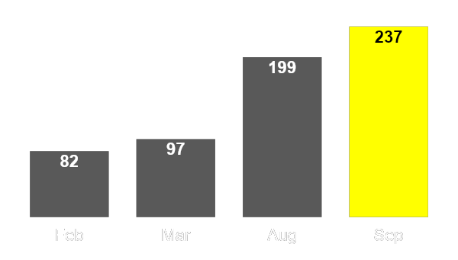




A Growing Problem
A lobster never stops growing, and neither did NetClaw
Why lobsters sink
Skills in the NetClaw catalogue, 2026
A lobster grows its whole life. Past a certain size, molting costs more than it has left, and the shell that protected it becomes the thing that sinks it.
237
2.9× Since February
The Monolith Problem
Context: ~194 skills and 37–52 MCP servers load into every turn
Secrets: one .env holds every credential for every integration
Blast radius: one confused or compromised agent reaches the whole estate
One model: the same model and cost for every task, large or small

Slide 60
The N2N Protocol Stack
BGP carries identity, NCFED carries the conversation
eN2N: mutual consent between operators
iN2N: Border + members, TOFU
Trust
One port, three protocols
MCP tools/call for deterministic tools
A2A agent cards, tasks, streams
The mesh daemon reads the first bytes of each connection:
Semantics
0xFF
BGP
NCFED
JSON-RPC 2.0 frames: [length][flags][payload], 13-octet handshake
N CTUN
data-plane tunnel
TLS with Claw Certification: ACME domain-verified or pinned keys
N CFED
+ AS + router-id = NCFED
Security
Zero new open ports. Federation works wherever BGP works.
BGP identity = AS + router-id · TUN real packets, same port
Mesh

Slide 61

NCFED Internet-Draft
Submitted to the IETF for the agent protocol effort
draft-capobianco-ncfed-00
STATUS
Individual Internet-Draft, intended Experimental, open for review
AUTHORS
John Capobianco, Nicholas Calcutti, Byrn Baker
SPECIFIES
BGP-multiplexed discrimination, 13-octet handshake, framing, eN2N and iN2N trust
VENUE
The IETF agentproto effort on agent protocols
READ IT
datatracker.ietf.org/doc/draft-capobianco-ncfed

Slide 62
Why a New Protocol?
Both MCP and A2A are JSON-RPC 2.0. The gap is semantics and transport.
MCP
A2A
NCFED
New
Strength
Run this tool, return the result. What NetClaw already speaks internally.
Agent cards for discovery, a task lifecycle, streaming messages.
MCP's tools/call plus A2A's cards, tasks and streams, on the BGP mesh port.
RESULT
Gap
Request/response only: no long-running delegated task, no streaming, no agent asking an agent to think.
Assumes HTTPS and a public discovery URL per agent: new inbound exposure on every claw.
Nothing new to open. Identity is AS + router-id, so it survives an endpoint change.

Slide 63

Enter iN2N: A Risk of NetClaws
A risk is the real collective noun for a group of lobsters
Purpose-driven claws
.env scoping
Smaller blast radius
Many small claws: each member owns one domain (CML, pyATS, Azure)
~3 skills + 1 vendor MCP per member, not 190
Right-sized models: any model per claw, including local Ollama
Least privilege: each member gets only its integration's .env slice
Master .env hidden by the OpenShell sandbox
Secrets never cross: NCFED inventories are scanned against .env before sending
Contained failure: a confused or compromised member reaches one integration, not the estate
One door: the Border is the single identity and audit trail
Fail closed: DefenseClaw guard and GAIT audit, or no delegation
Carried by NCFED: members dial the Border outbound, so there is no ngrok, no mesh and no inbound port.

Slide 64
iN2N: A Risk of NetClaws
One operator, many focused claws, one Border
External peers (eN2N)
Why run a risk
Focus: each member carries ~3 skills, not 190
Least privilege: a member gets only its own integration's secrets
Any model: per claw, including local Ollama
Cold members start on first use
Production mode: OpenShell sandbox, DefenseClaw guard and GAIT audit, fail closed
Border Claw
one door, one identity, one audit
CML claw
pyATS claw
Azure claw
Mobile edge
A standalone NetClaw is a risk of one: its own Border.
Members dial the Border outbound: no ngrok, no mesh, no inbound ports.

Slide 65



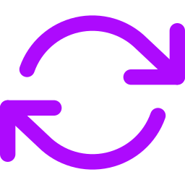
eN2N: Federation Across Operators
Independent NetClaws, run by different people, on their own terms
What Federation Unlocks
The Trust Model
Mutual consent per peer, before anything crosses
Default-deny per-peer, per-tool grants, optional approval
Budgets daily request and token limits per peer
No secrets inventory scanned against .env before it leaves
Untrusted input remote results are data, never commands
Kill switch N2N stops in under 10 s; BGP stays up
Dual-side audit both claws record who asked and what ran
Capability discovery
Remote invocation
signed inventory of skills and MCP tools
runs on the owner's claw, with the owner's credentials
Claw-to-claw chat
Async delegation
answers attributed to the peer that gave them
submit, poll, fetch; survives restarts

Slide 66
Demonstrated Live
Three operators, three ASNs, one federated mesh
john@as65001
John
> "Have Nick's claw recreate my lab in his CML."
AS 65001
n2n_delegate(peer="as65007-7.7.7.7",
target_name="cml-lab-lifecycle")
=> task_id, state: submitted (~2 s)
n2n_task_status => working "nodes 4/10"
n2n_task_status => working "links 12/12"
n2n_task_result => completed
"lab up, OSPF adjacency formed"
Nick
Byrn
AS 65007
AS 65099
Async delegation
keeps every call short enough to outlast an ngrok tunnel, and the task survives a restart mid-build.
eBGP + NCFED across the internet, three separate operators

Slide 67
GCF: Graph Compact Format
A token-efficient encoding for what MCP servers send back to the model
55–83%
First query
55–83% token savings on network data
Re-queries
Up to 99% savings with delta encoding
fewer tokens on network data than the raw MCP response
Why it matters
More context left for reasoning
Same data, fewer tokens
Fewer tokens per MCP call means lower cost per loop.
Source: NetClaw repository, github.com/automateyournetwork/netclaw

Slide 68

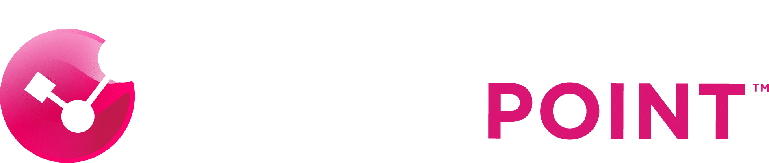



Industry Participation
Vendors building MCP servers and skills with NetClaw
65+
15
10
54
37
Platform tools: config management, compliance, workflows, lifecycle
MCP servers: policy, threat intel, gateway, SASE, malware
MCP tools: health, path analysis, diagrams, API discovery
tools: digital twin and NQE, path analysis, intent checks
tools each in Percepxion and SLC: co-developed out-of-band MCP servers
Also building with NetClaw: Cisco (DefenseClaw, DevNet MCPs), NVIDIA (OpenShell), Claroty, Juniper, NetBox Labs, OpsMill

Slide 69
Your documents become NetClaw’s knowledge base
A native, fully offline RAG MCP server; answers come back with citations
Feed it
Drop a file in Slack; it is learned
Ingest files on disk or a web page
PDF, Markdown, HTML, text, Office
Tag docs with type, title, version
Vendor documentation
Install guides, CLI references, release notes
Internal change guidelines
Change windows, approval rules, naming standards
MOPs and SOPs
Step-by-step procedures the agent follows and cites
Customer standards
Golden configs and design rules per customer
RAG is what you upload; memory is what NetClaw learns. Live network state always comes from the devices, never from documents.
Hybrid dense + BM25 retrieval with a local reranker; ChromaDB and SQLite stored locally. Source: NetClaw TOOLS.md.

Slide 70
Every major lab and twin platform, driven in plain English
Build, break and test in a virtual network before anything touches production
Emulate: virtual labs you can break
Cisco CML
Build labs, wire links, run CLI, capture packets
ContainerLab
SR Linux, cEOS, IOS XR, NX-OS, FRR, cRPD
EVE-NG
8 skills: discovery, design and build
GNS3
Projects, snapshots, packet capture (26 tools)
Model: twins and analysis of the real network
Forward Networks
Digital twin, path analysis and intent checks
IP Fabric
Network assurance: snapshots, paths, compliance
Batfish
Test a config change offline, no device needed
SuzieQ
Multi-vendor state, queried and compared over time
The loop: pull production config → clone into a lab → test the change → check the twin → approve → push.

Slide 71
All the Itential demos you’ve seen me do? That’s NetClaw
NetClaw drives the Itential Platform through the Itential MCP (65+ tools) and Builder Skills
Workflows
List, start and track Itential workflows and jobs from chat
Golden config
Render templates against golden config trees
Compliance
Run compliance plans before and after every change
Config backup and push
Back up first, then apply, gated on a ServiceNow CR
Command templates
Bulk command runs across the fleet
Builder Skills
Spec to as-built: agents design, build and test Itential assets
Itential is the governed execution layer; NetClaw is the agent that talks to it. Ask in Slack, Teams or by voice, and the work runs as audited Itential jobs.
Watch: “NetClaw with Itential Skills and MCP” (YouTube) and “When AI Agents Talk to Each Other: NetClaw, Itential Platform & FlowAI” (itential.com).

Slide 72
NetClaw shows you the network, not just tells you
From a mind map in chat to a digital twin in Unreal Engine 5
Mind maps & diagrams
2D, generated in seconds
Markmap
Protocol hierarchies as mind maps
Draw.io
Topology color-coded by reconciliation
Excalidraw
Hand-drawn style whiteboards
Kroki
27+ types: nwdiag, rackdiag, Mermaid, D2, Graphviz, C4
Live in the conversation
Inline and real time
Canvas / A2UI
Topology, dashboards, timelines and diffs in chat
Visual HUD
Three.js 3D operations dashboard
Grafana
Dashboards, Prometheus and Loki
3D digital twins
A network you can walk through
Blender
3D models of the topology, built over MCP
Unreal Engine 5.8
A live CML topology cloned into a 3D world
Every view is generated from live state gathered by pyATS, NetBox and the MCPs, so the picture matches the network.

Slide 73


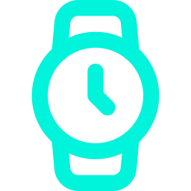

NetClaw Mobile
Your network in your pocket, with nobody in the middle
iPhone
iPad
Apple Watch
Android
Nobody in the middle
Talk to your own Border: review actions and get answers on the go, by voice or photo
No Slack, Discord or Webex between you and your agent. The phone talks straight to the Border you host, over NCFED.
Enroll with a QR code: single-use token over WebSocket-over-TLS
Same trust as any member: domain-verified or pinned-key credentials
Demonstrated
an iPhone talking to an Android through one Border, with voice, photos and a live CML lab.
No agent runtime on the phone: the Border does the work; the phone is an edge
Native surfaces: Live Activities, Siri App Intents, widgets, watch complications
App Store: NetClaw, for iPhone, iPad and Apple Watch

Slide 74

NetClaw in Zoom
Meeting context becomes investigation evidence
Zoom meeting
NetClaw
Investigation
transcript and chat stream in
correlates with live network state
evidence lands beside the chat
Live
History
Zoom RTMS MCP
zoom-meeting-context
Realtime Media Streams bring the meeting transcript and chat into an investigation, when configured.
“Didn't we see this before?” It finds the prior real meeting, says plainly when nothing matches, and compares what was said then with the network now.
Read-only. A change requested in a meeting still goes through the device-write approval gate.

Slide 75
Phone your NetClaw, or let it phone you
Bidirectional voice and SMS through Twilio
You call NetClaw
Dial the claw’s number and talk to it like an on-call engineer
Ask for device health, a BGP summary or the last change
It answers in speech, then follows up by SMS or Slack
NetClaw calls you
An alert or failed heartbeat check triggers a phone call
It explains what broke and what it has already checked
You approve or decline the next step by voice
Voice is just another channel: the same skills, approval gates and audit trail apply on every call.
Demo: “NetClaw can now phone you! And you can phone NetClaw!” on YouTube.

Slide 76
Jev gives agents a fast System One for small decisions
Snap judgments go to a decision model; the LLM keeps its reasoning for the hard problems
SYSTEM ONE
Jev, from TypeSafe AI
Returns typed decisions, not text: a choice, a score or a yes/no probability
Answers every question in one parallel pass
Calibrated probabilities tell your code how far to trust each answer
70–500 ms per call (vendor figure)
SYSTEM TWO
A frontier LLM
Generates text one token at a time
Reasons through multi-step problems and calls tools
Slow and expensive when all you need is “which bucket is this?”
Output still has to be parsed and validated
In a network loop: Jev triages each alert; NetClaw investigates the ones that matter.
Source: TypeSafe AI, Jev launch announcement, September 15, 2026. Latency is the vendor's claim, not independently tested.

Slide 77
Jev is the Spock to the Border’s Kirk
In a risk of NetClaws, Jev advises with fast typed decisions; the Border makes the call
Border Claw · Kirk / Picard
Takes the request, weighs the advice, makes the call
Jev · Spock / Data
Answers typed questions in 70–500 ms; never acts
asks · advises
pyATS claw
Device state
CML claw
Lab and digital twin
Azure claw
Cloud network
Security claw
DefenseClaw, CVEs
What the Border asks Jev before it routes
Choice: Which member claw owns this?
Score: How risky is this change, 1 to 5?
Yes / no: Does a human need to approve?
Logic advises, the captain decides, the crew executes. Every Jev answer comes with a calibrated probability.
Jev latency is TypeSafe AI’s own figure (Jev launch, Sept 15, 2026). Member claws shown are examples.

Slide 78
NetClaw in VS Code
Your network workbench, beside your code
Chat and Canvas
Talk to your claw and see inline visualizations in the editor
22 observation views
Inventory, configuration and topology, including a 3D BGP view
Integrated RAG
Document-grounded answers without leaving VS Code
Testbed and MCP setup
Manage testbeds and configure each MCP server
Security controls
Reviewed DefenseClaw and OpenShell controls
Claw controls
Edit SOUL.md, AGENTS.md and more; start, stop, restart
A thin client: NetClaw keeps execution, NCFED, authorization and audit. On the VS Code Marketplace.

Slide 79
NetClaw is built by a community
Thank you to the people who turned one repo into a project
Byrn Baker
netclaw.network, the video series, maintenance, Cisco DevNet Webinar, NCFED co-author
Sean Mahoney
The official NetClaw documentation and user guide
Justin Brenton
NetClaw Mobile for iOS, Android and watch, maintainer
Nicholas Calcutti
Maintainer and NCFED Internet-Draft co-author
Adam Mason
Canvas, the branching investigation workspace
Alex Bugheanu
Risk rules: read-only runs free, changes ask on Telegram
Jason Bartels
Community story and early adopter feedback
Dayna Blackwell
GCF, the token-efficient format that replaced TOON across NetClaw's MCP servers
Plus dozens of testers, PR authors and lab builders: automateyournetwork.com/netclaw/#community · VibeOps Forum on Slack

Slide 80
NetClaw Around the World
15 community stories in 6 languages
United States
France
Brazil
China
English · 8 stories
English · 1 story
Portuguese · 1 story
Chinese · 1 video
Byrn Baker, Sean Mahoney, Alex Bugheanu, Jason Bartels
Younes Jellabi: CVE monitor from NetBox and NVD
Tomy T.: NetClaw inspired his AI Network Lab
乾颐堂: Technology Evolution 2026, Episode 14
Poland
Vietnam
Japan
15
Polish · 2 videos
Vietnamese · 1 review
Japanese · 1 guide
MP STUDIO: AI fixes a network; a Discord network bot
VnPro forum: a hands-on NetClaw setup
zephel01: the OpenClaw ecosystem guide
Stories
6 languages, 7 countries

Slide 81
Backed by the AAIF and the Linux Foundation
The foundation behind MCP gave NetClaw a main stage and its blog
MCP Dev Summit Toronto
October 6, 2026
NetClaw presented on stage to a packed room at the AAIF's own MCP conference
Official AAIF blog
October 14, 2026
“I Saw Something in MCP. Then I Spent 18 Months Building It.” The NetClaw story, from a first MCP server to Toronto
Who is behind this work: the Agentic AI Foundation, the Linux Foundation's neutral home for MCP, co-founded by Anthropic, OpenAI and Block
Source: aaif.io/blog, “I Saw Something in MCP. Then I Spent 18 Months Building It.”, October 14, 2026

Slide 82
Get Started
terminal
$ git clone https://github.com/automateyournetwork/netclaw.git
$ cd netclaw && ./scripts/install.sh
OR USE THE VS CODE EXTENSION FOR AN IDE EXPERIENCE
Or start in your IDE
Install NetClaw from the VS Code Marketplace
Connect it to your OpenClaw or Hermes install
Chat, Canvas, RAG and testbeds beside your code
Resources
github.com/automateyournetwork/netclaw
github.com/openclaw/openclaw
github.com/nhowardtli/virp
automateyournetwork.com/netclaw
datatracker.ietf.org/doc/draft-capobianco-ncfed
NetClaw Mobile on the App Store
Vibe Ops Forum on Slack

Slide 83


Slide 84
Questions?
The next 10 minutes are yours.
John Capobianco
Head of AI and DevRel, Itential
github.com/automateyournetwork/netclaw

Slide 92
Questions?

